Slide 1
Highlights & Next Steps re: Main Street America Project
Presented by:
Indian lake Community Development Corp. & Town of Indian lake

Slide 2
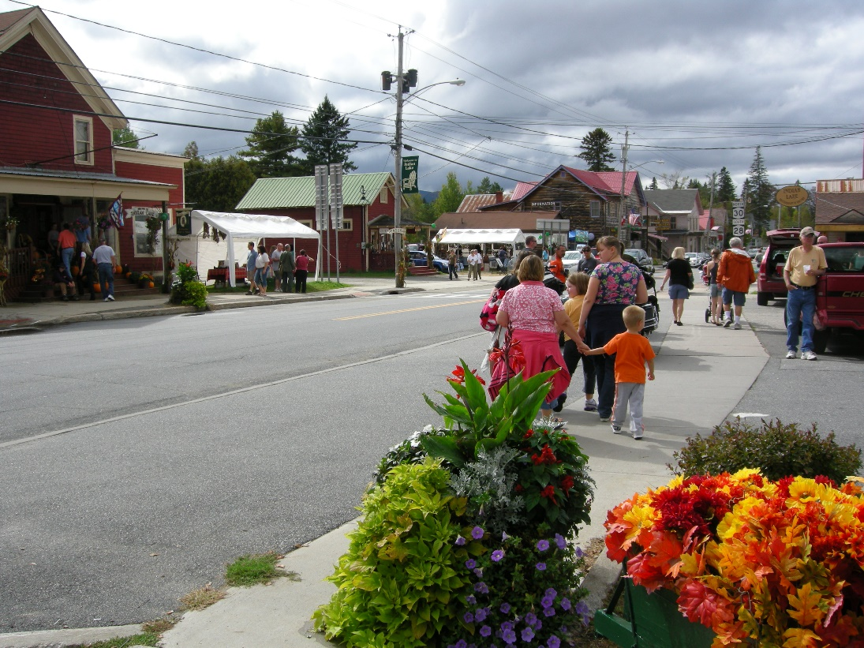
Tonight’s Agenda
What we learned from the community survey
What happens next
How to get involved

Slide 3
Overview
Lisa Thompson, a Main Street America consultant, visited our community on August 25-26, 2022. She provided us with a strategic report to help us understand what our community envisions for revitalization of downtown business districts.

Slide 4
What we learned from the community survey (229 respondents)
Q1. What words come to mind when you think about Indian Lake? A. Pine’s; small community; and walkable.
Q2. What do you dislike?
No Grocery store; rundown; and empty.
Q3. What are the top issues in Indian Lake?
A. Too many vacant storefronts; not enough interesting businesses; and not enough consistently open business.
Q4. Issues that detract from your experience in Indian Lake?
A. Housing insecurity; no grocery store; and not enough interesting and attractive businesses.
Q5. What businesses do you frequent the most?
Pine’s; Stewart’s; and Indian Lake Restaurant.
Q6. What businesses would you like to see opened?
Grocery store; brewery or winery; and coffee shop or bakery.
Q 6-7. What day and time do you shop the most often?
Saturdays from 9am to 11am.

Slide 5
What we learned from the community survey
OTHER INFORMATION INCLUDES:
Most respondents were year-round residents.
Most stay in their second home when they visit here.
If seasonal, residents mostly visit in August and September;
followed by July and October.
Most visitors/tourists typically stay here less than one week;
and secondly 1-2 weeks.
Most respondents were ages 55-64; 65-74; and 45-54.
89% of respondents were White.
60% of respondents were women; 40% men.

Slide 6
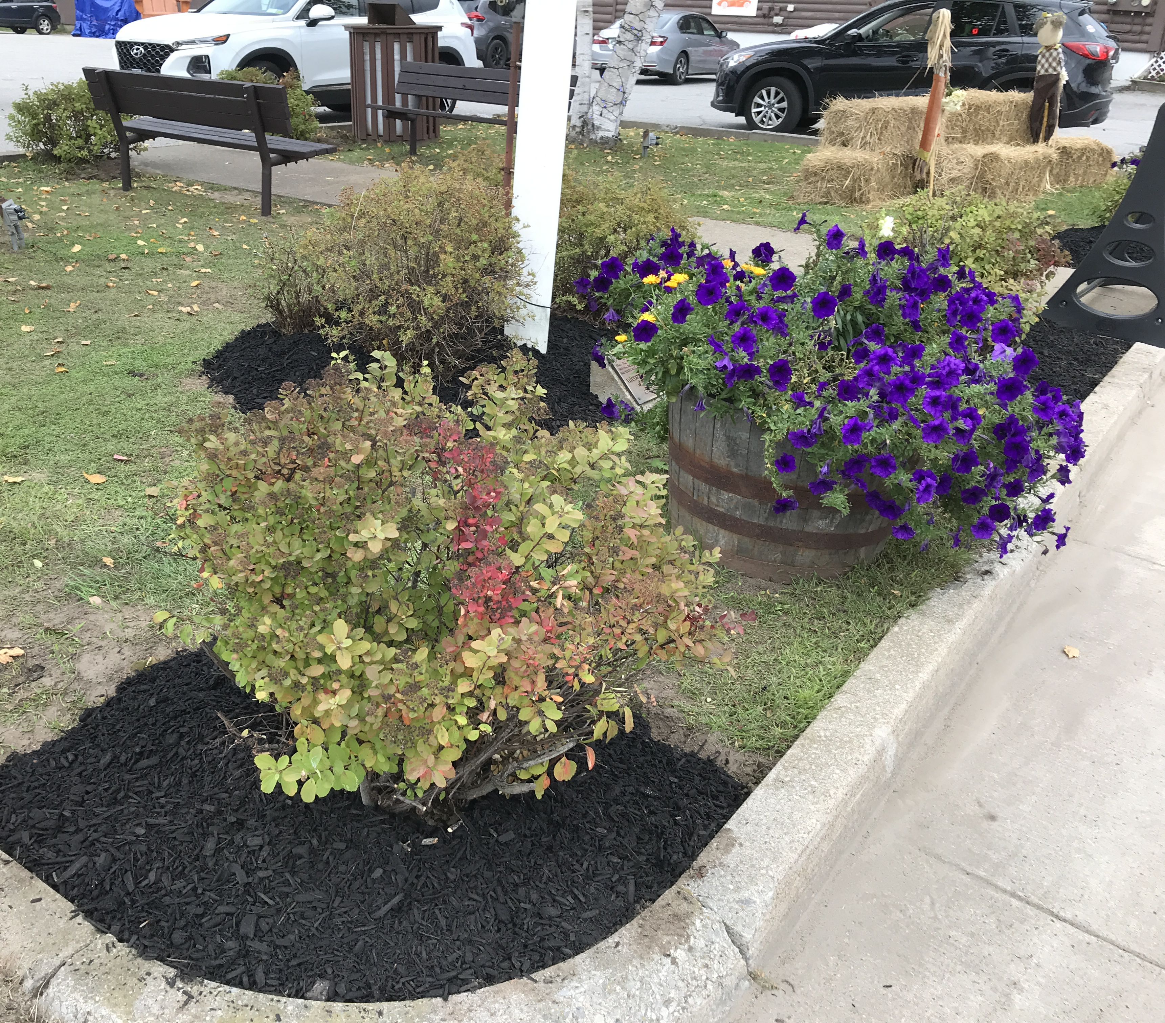
What Happens Next? “The way to get started is to quit talking and begin doing.” Walt Disney
Photo is an easy and quick example how we freshened up the benches and plantings in the pocket park.

Slide 7
Community Transformation via MSA 4 Point Approach Defined
Economic Vitality
Strengthen & diversifies the local economy supporting existing base, entrepreneurism and appropriate development.
Design
Improves physical elements while preserving the community's authentic fabric, character & identity.
Promotion
Positions district as the center of activity, culture, commerce, and community life, markets its assets and positive image.
Organization
Brings the community together to build consensus & common vision, assemble resources, and lead revitalization.

Slide 8
Community Transformation via MSA 4 Point Approach General Examples
Economic Vitality
Supporting the needs of existing & new businesses; trainings; loan & grant funds; inventory vacant buildings; survey business owners to discover needs.
(Funding)
Design
Beautification; wayfinding; accessibility and safety; minor/easy maintenance; and façade improvements.
(Image)
Promotion
Overall branding; unify/link hamlets; identify historic landmarks; and market our assets.
Elder & family friendly promo.
(Events)
Organization
Engaging all parties to get involved; establish common vision; lead the revitalization; and keep things on track.
(Structure/Name)

Slide 9
Community Transformation Specific Examples
Economic Vitality
Use our online business directory to highlight a business of the week/month.
Start a “love your local” program
Develop a packet to attract new businesses/developers to support additional recreational offerings (outfitters, equipment rental)
Work with businesses to provide a range of “open” opportunities/stager closings.
Establish loan/grant programs just for main street businesses for upgrades/improvements
Design
Develop wayfinding signage to identify businesses and amenities.
Conduct sidewalk safety/walkability inventory list.
Add bike lanes.
Community gardens/flowers galore.
Dog park and sanitation stations.
Downtown lighting review.
Residents ONLY parking.
Benches, bike racks and trash cans
Bike rentals
Fitness stations on trails.
Water refill stations.
Promotion
Welcome Packet (we have this now!)
Community calendar inclusive of ALL events.
Infor for LOCALS ONLY on website.
Print & digital newsletter.
Host events that serve residents only – Trick or Treat, Easter egg hunt, Locals shopping night.
News releases and social media videos to promote our efforts.
Downtown Dollars program.
Promote hashtag #indianlakeadk
Organization
Create volunteer database for events and activities.
Promote historic walking tours.
Partner with other communities to promote regional amenities.
Develop bike tours.
Shuttle service.
Support funding efforts.

Slide 10
How to get involved? 1. Consider joining one of the 4 working groups: Economic Vitality; Design; Promotion; and Organization. 2. Consider being a chair or co-chair for a working group. 3. Contact one of the core committee members to learn more & ask questions.

Slide 11
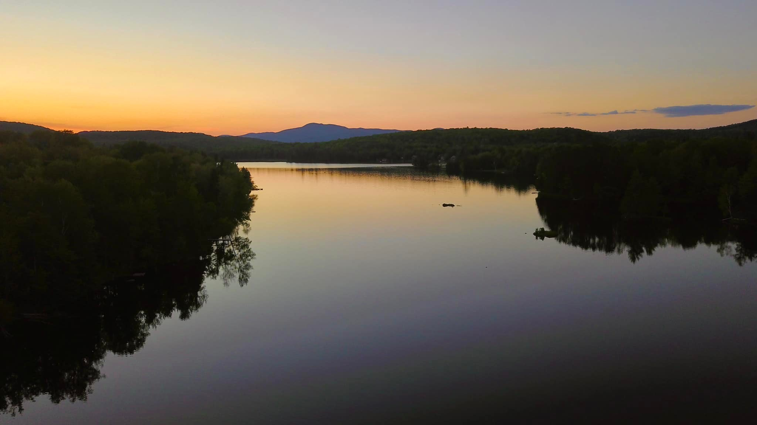
Contacts: Core Committee Members
Indian Lake Community Development Corp. –
Brenda Valentine @
518-648-5636
Town of Indian Lake – Christine Pouch @
518-648-5828
Allen Van Hoff @
518-441-2640
Sally Stanton @
518-648-5179

Slide 12
Thank you. We look forward to working with you!

